Slide 1
2023 Physiology Campaign Display Items and General Discussion
January 16, 2023
January 23, 2023

Slide 2
Statistical Approach
Linear mixed effect models
Alliaria treatment included as categorical fixed effect in all models
Soil characteristics
Variable ~ Alliaria treatment * tree canopy status + (1 | plot)
Physiology traits
Variable ~ Alliaria treatment * tree canopy status * (soil N availability +
phosphate availability) + (1 | plot)

Slide 3
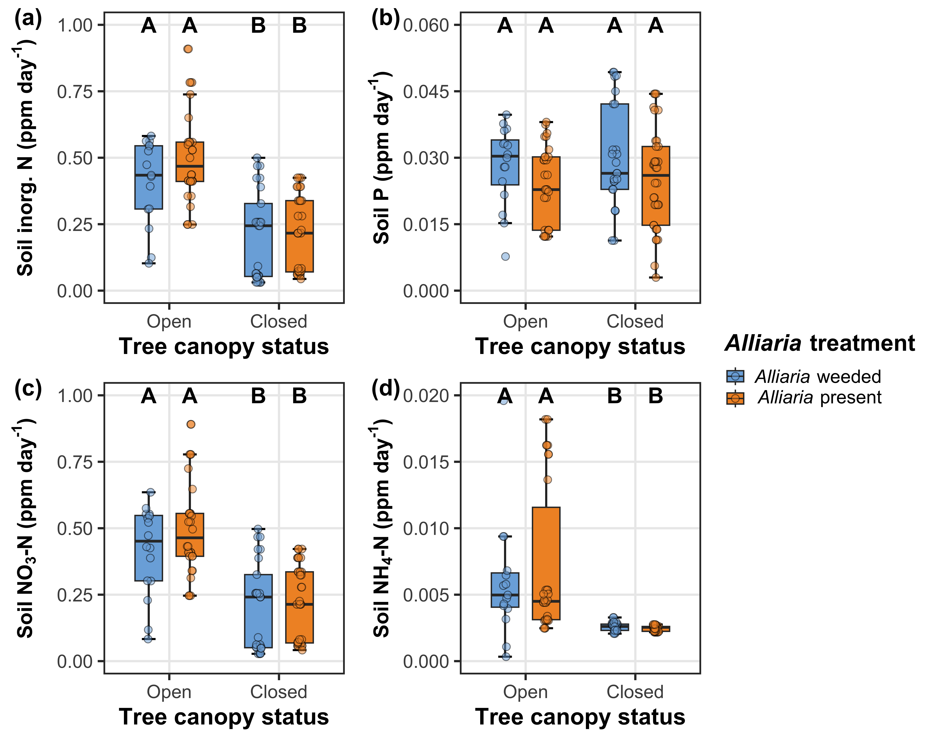
Alliaria presence does not affect soil nutrient availability
Soil nitrogen availability decreases with tree canopy closure

Slide 4
Statistical Approach
Linear mixed effect models
Alliaria treatment included as categorical fixed effect in all models
Soil characteristics
Variable ~ Alliaria treatment * tree canopy status + (1 | plot)
Physiology traits
Variable ~ Alliaria treatment * tree canopy status * (soil N availability + soil phosphate availability) + (1 | plot)

Slide 5
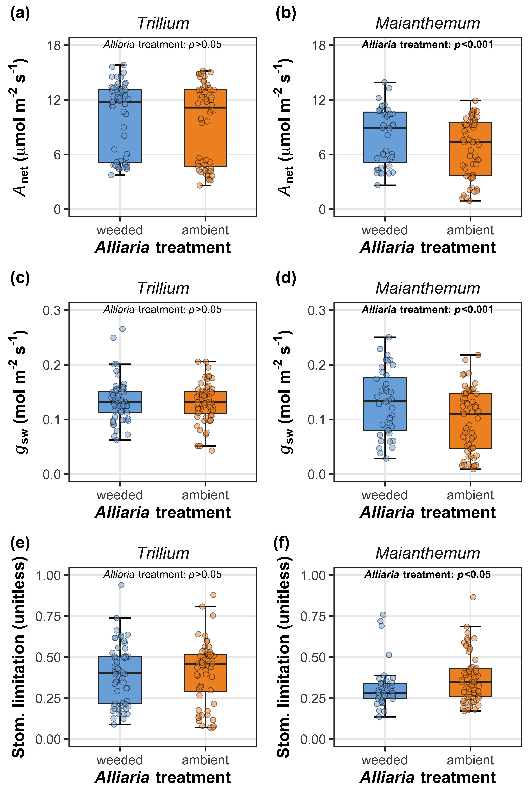
Alliaria does not modify Trillium net photosynthesis or stomatal conductance
Alliaria decreases Maianthemum net photosynthesis and stomatal conductance

Slide 6
Alliaria decreases Trillium V_{cmax25} and J_{max25}, but only when the tree canopy is closed
Alliaria does not change Maianthemum V_{cmax25}, but decreases J_{max25} when the tree canopy is open

Slide 7
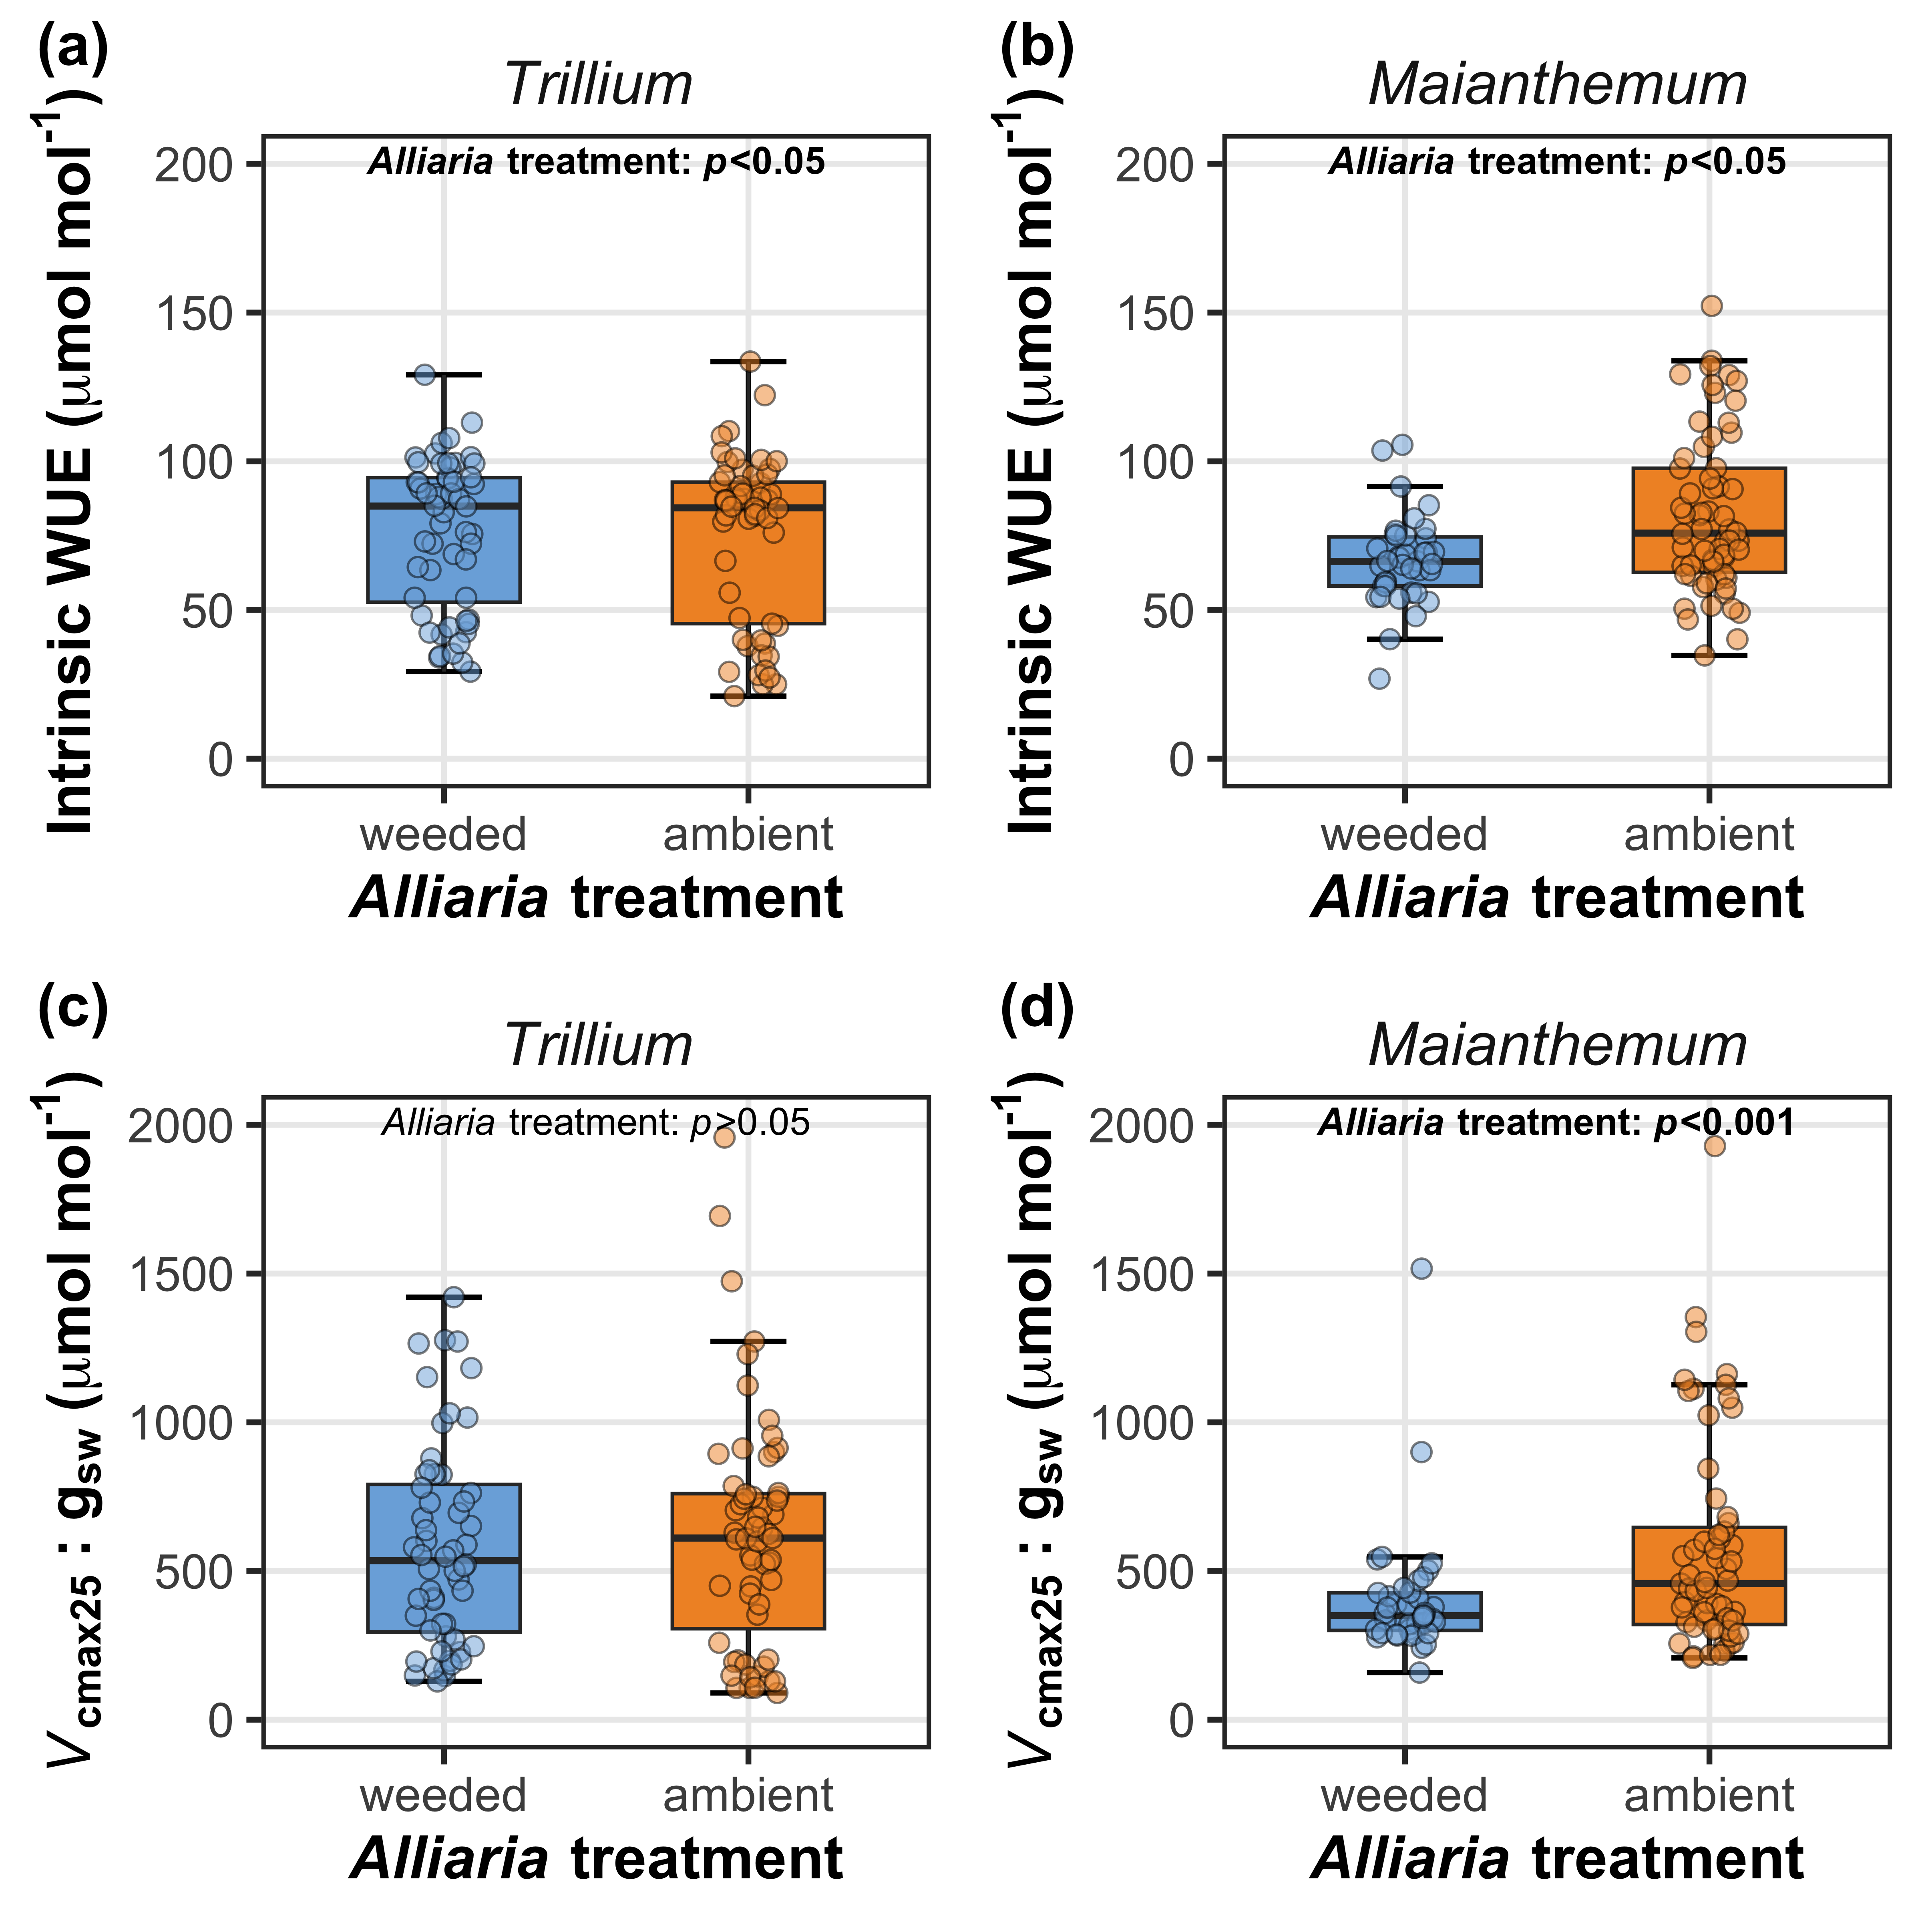
Alliaria increases Trillium iWUE but does not alter V_{cmax25}:g_{sw}
Alliaria increases Maianthemum iWUE and V_{cmax25}:g_{sw}

Slide 8
Key takeaways (so far)
Alliaria presence decreased Maianthemum net photosynthesis through reduced stomatal conductance
No effect of Alliaria presence on indices of photosynthetic capacity (but see reduced J_{max25} when tree canopy is open)
Suggests that Alliaria presence may alter Maianthemum cost of H₂O uptake?

Slide 9
Key takeaways (so far)
Alliaria presence decreased Trillium photosynthetic capacity, but only after tree canopy had closed
No effect of Alliaria presence on Trillium net photosynthesis or stomatal conductance
Alliaria presence may increase Trillium cost of nutrient uptake
May only be apparent when soil resources are low and/or reliance on AM fungi increases

Slide 10
Main takeaway
Alliaria invasion has negative impacts on native species physiology, but mechanisms underpinning these responses responses are species-specific

Slide 11
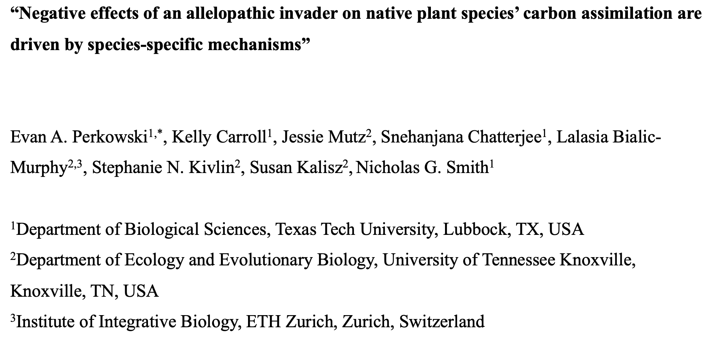
Proposed title and author list
Is there anyone missing here?
Notes:
First few authors ordered based on perceived contributions thus far, followed by alphabetical list of ECR and PI list

Slide 12
Some questions/logistics to discuss
Does it make sense to include an assessment of AM community composition here?
Alternative: sister paper submitted alongside this paper?
Do these results merit standalone paper?
Alternative: merge findings with this summer’s physiology campaign, which will have finer temporal resolution over longer measurement period

Slide 13
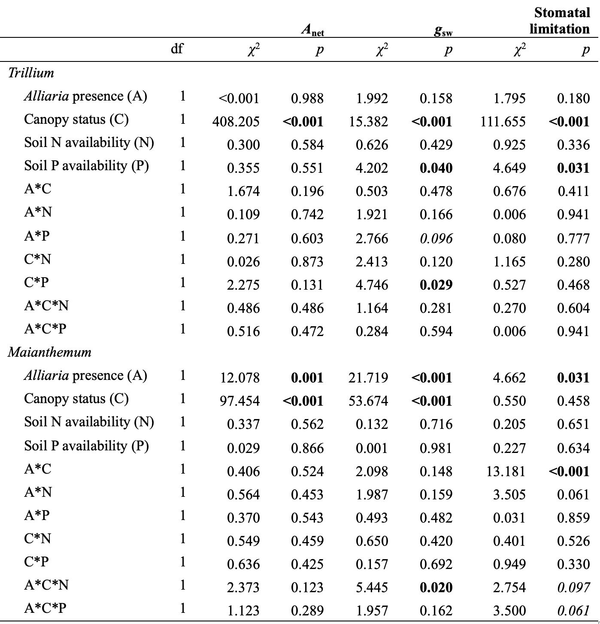
Tree canopy closure decreases net photosynthesis and stomatal conductance
Soil P increases Trillium stomatal conductance, but only when canopy is open
Soil N increases Maianthemum stomatal conductance but only in weeded plots where the canopy is open

Slide 14
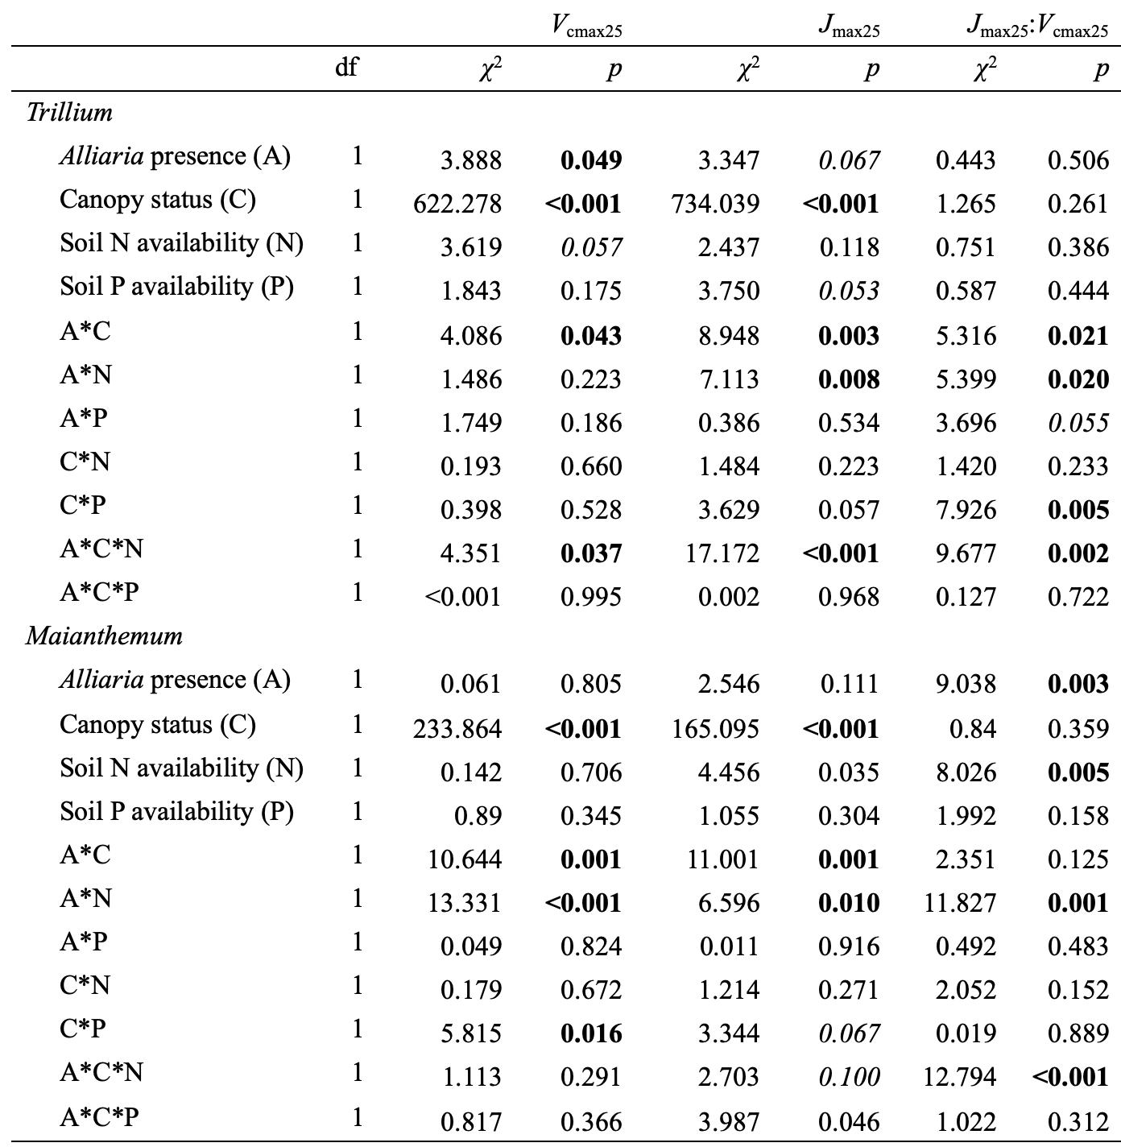
Tree canopy closure decreases net photosynthesis and stomatal conductance
Soil N decreases Maianthemum photosynthetic capacity in weeded plots (?)
Soil N increases Trillium photosynthetic capacity only in weeded plots where the canopy is closed

Slide 15
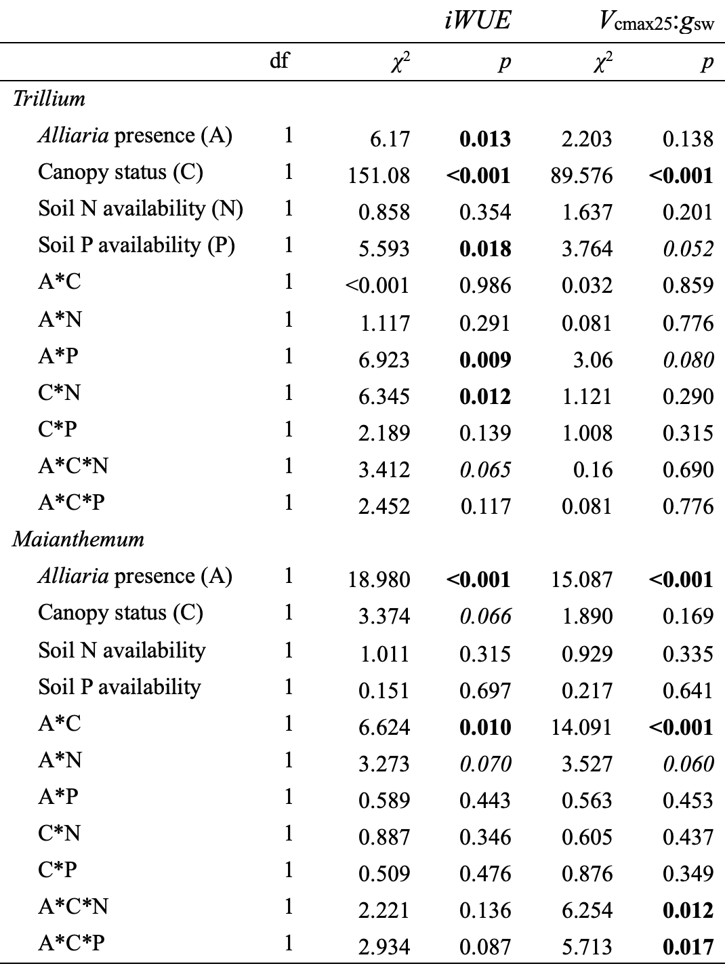
Tree canopy closure decreases iWUE and V_{cmax25}:g_{sw} in Trillium
Soil P decreases Trillium iWUE in weeded plots only

